Slide 1

HCI - Assignment n.2
Design and prototyping of an application using a human-centered approach
Final presentation and demo
Project Title: BatalhaBus, a entertainment/multimedia system for bus rides
Group: Rafael Ferreira, João Luís & Rodrigo Aguiar
Lab Class: P5
HCI 2022-2023

Slide 2
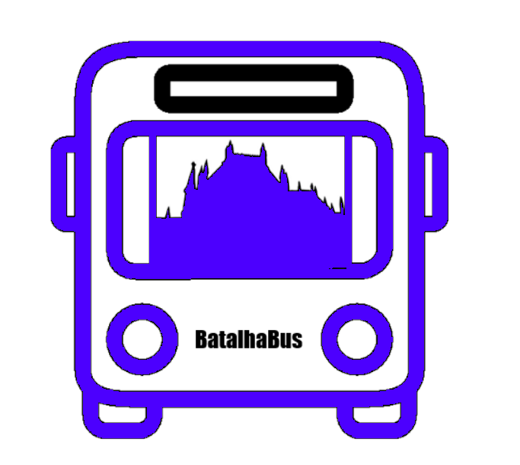
Introduction
BatalhaBus
Ever gone on a boring, long and dreadful bus ride?
We believe we could improve bus rides into something more fun and informative
The members of the team regularly use bus as a transport method, so we feel there is a need for some innovation in the field
HCI 2022-2023
‹#›
Notes:
Brief contextualization / motivation.
Why this project?
Relation to other courses? (e.g. Data Bases, Project…; optional)
Personal Interest? Elaborate.

Slide 3

Project Objectives
BatalhaBus
Provide the user with information about the bus ride while on the move
Provide an entertainment system integrated within the bus
Our project aims to provide a clean, beautiful and intuitive interface for every bus passenger
Integration of popular apps within the system
HCI 2022-2023
‹#›
Notes:
Define high-level goals.
What are the expected outcomes?
What are the benefits?

Slide 4
Methodology
BatalhaBus
User-centered methodology
Users and context of use
Creation of Personas
Design guidance
1st
3rd
5th
2nd
4th
6th
Requirement Analysis
Development of scenarios
Usability testing

Slide 5

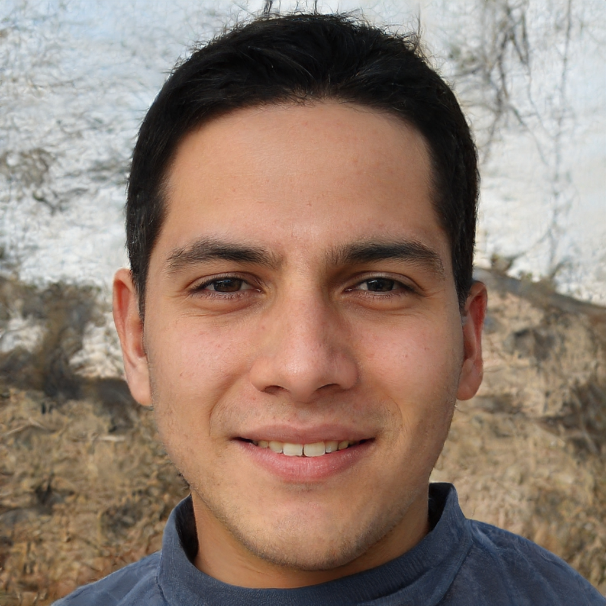
Personas
BatalhaBus
Name: Mário Silva
Gender: Male
Age: 20
Location: Golpilheira (Leiria)
Profession: Student in Covilhã
Environment: Fluent with technology
Problems: Eyesight issues
Goals:
Be able to watch Youtube videos or movies in the bus
Be able to listen to music
Needs:
A entertainment system that is built-in in the bus
A visible brightness slider in the device
Mário Silva
HCI 2022-2023
‹#›
Notes:
Select 1 or 2 main target users;
Define the corresponding personas:
Include name, gender, age, profession, background, main motivations, goals and needs …
Do not void too much detail (include only information relevant to your problem

Slide 6
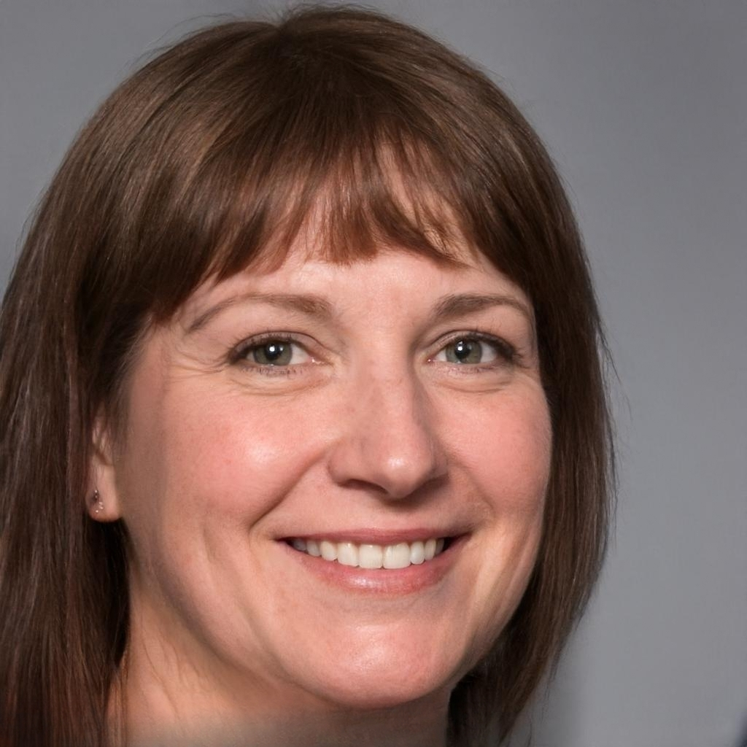
Personas
BatalhaBus
Name: Floribela Rodrigues
Gender: Female
Age: 48
Location: Lourosa
Profession: Industrial Worker in Ovar
Environment: Little experience with technology
Goals:
Be able to catch up on news in the bus
Be able to see all details about her bus ride
Needs:
A system that is easy and intuitive to use
Integrations for applications she already uses on her phone
Floribela Rodrigues
HCI 2022-2023
‹#›
Notes:
Select 1 or 2 main target users;
Define the corresponding personas:
Include name, gender, age, profession, background, main motivations, goals and needs …
Do not void too much detail (include only information relevant to your problem

Slide 7
Scenarios
BatalhaBus
1. Mario was previously listening to a podcast at home and wants to keep listening to it while he is on the bus
2. Floribela is currently on a bus trip and forgot if she has to swap to another bus at the next stop or not
3. Floribela heard the bus on her trip back home will be delayed, so she checks the platform to see the updated timetables
HCI 2022-2023
‹#›
Notes:
Define context of use through 1 or 2 main scenarios including the personas you have defined
Define short concepts or descriptions of how users (personas) will use the application
Should not go into too much detail

Slide 8
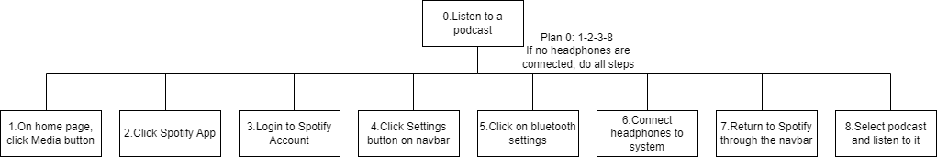
Scenario 1
BatalhaBus
HCI 2022-2023
‹#›
Notes:
For each scenario indicate the main tasks that users will perform using the application;
Identify relevant issues of the context of use, if necessary (e.g. mobile usage, noise, dust, stress level, etc.);
Which tasks will become easier using the application (taking advantage of the new capacities) and how they are performed currently (without the application)?
Include the decomposition of the main task.

Slide 9
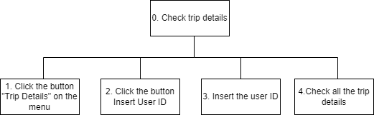
Scenario 2
BatalhaBus
HCI 2022-2023
‹#›
Notes:
For each scenario indicate the main tasks that users will perform using the application;
Identify relevant issues of the context of use, if necessary (e.g. mobile usage, noise, dust, stress level, etc.);
Which tasks will become easier using the application (taking advantage of the new capacities) and how they are performed currently (without the application)?
Include the decomposition of the main task.

Slide 10
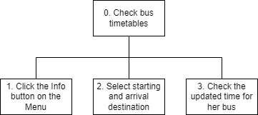
Scenario 3
BatalhaBus
HCI 2022-2023
‹#›
Notes:
For each scenario indicate the main tasks that users will perform using the application;
Identify relevant issues of the context of use, if necessary (e.g. mobile usage, noise, dust, stress level, etc.);
Which tasks will become easier using the application (taking advantage of the new capacities) and how they are performed currently (without the application)?
Include the decomposition of the main task.

Slide 11

Requirements
BatalhaBus
Functional
Be able to show the current location of the bus, as well as the start and end location of the ride.
Show full trip info based on a ticket ID provided by the user
Display timetables for bus rides
Must have integrations with other popular social media / entertainment applications
Non-Functional
The system must support multiple languages
The various icons and buttons in the system must be clearly visible
Color theme must be appropriate
The system should be reliable and secure
HCI 2022-2023
‹#›
Notes:
Define a set of requirements (non-functional, functional, …) based on the objectives and personas:
Non-functional requirements – specify the main usability requirements
(ease of learn or ease of use? …) and other that would be the most relevant (privacy, …);
Functional Requirements - specify the main functionality the application should support.

Slide 12
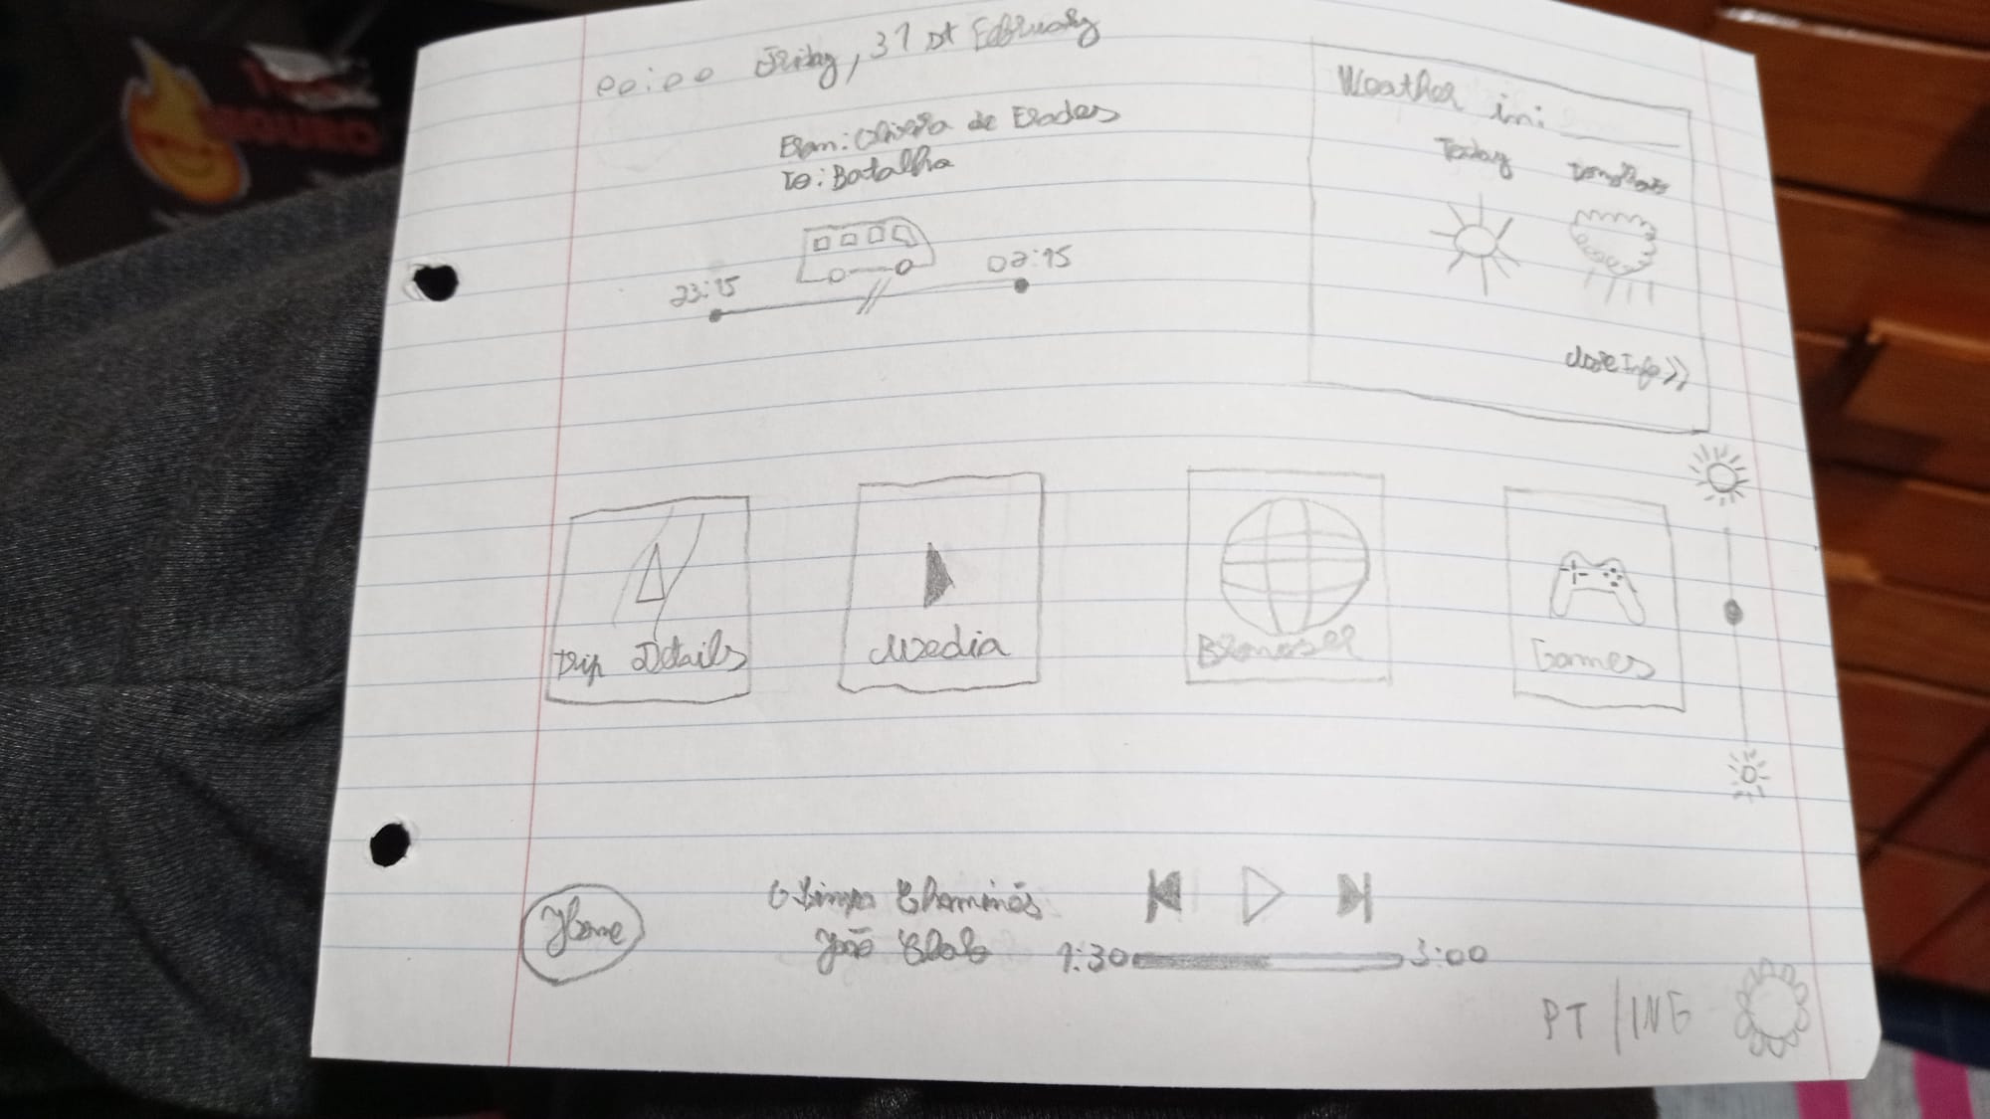
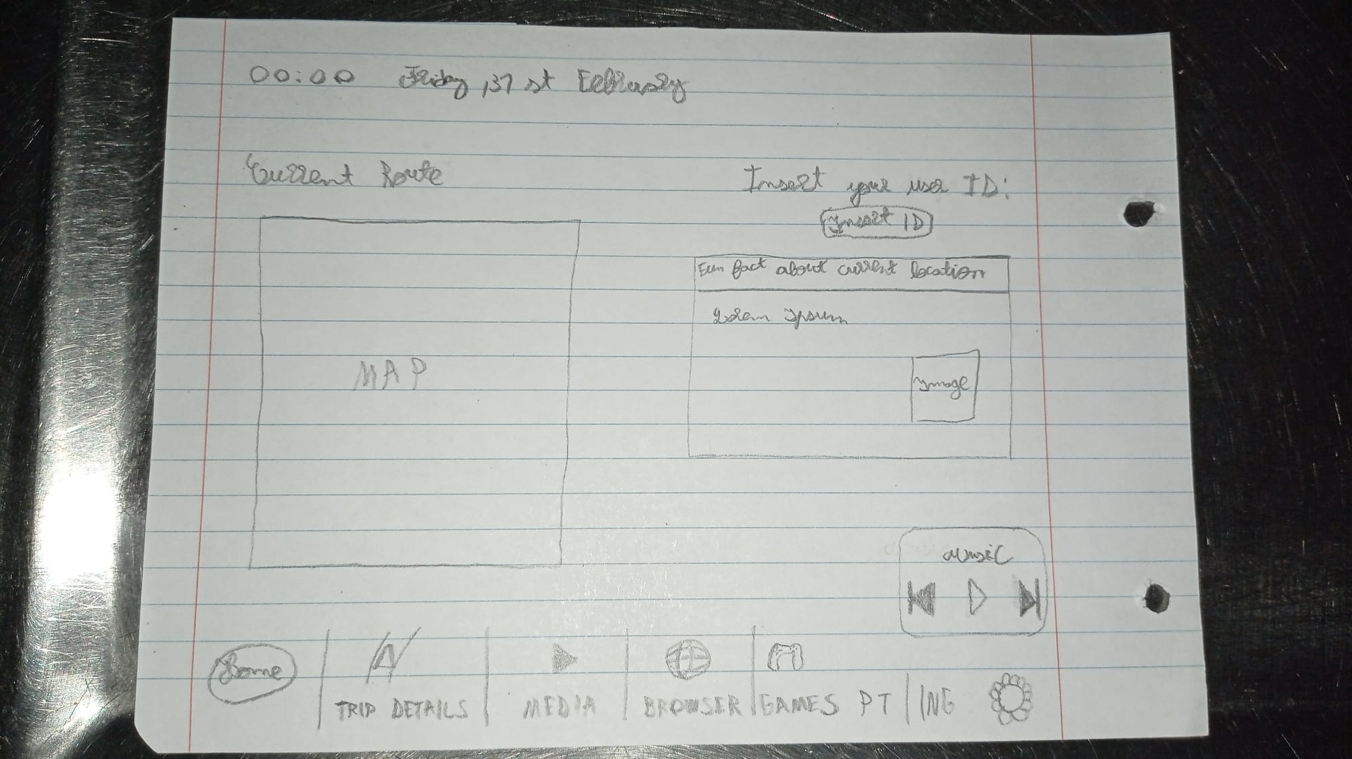
Low Fidelity Prototype (LFP)
Initial Papel Prototype
Home Screen
Trip Details Page
HCI 2022-2023
‹#›
Notes:
General layout of the system
Check current location of the bus and trip details
Check timetables
Play some games

Slide 13
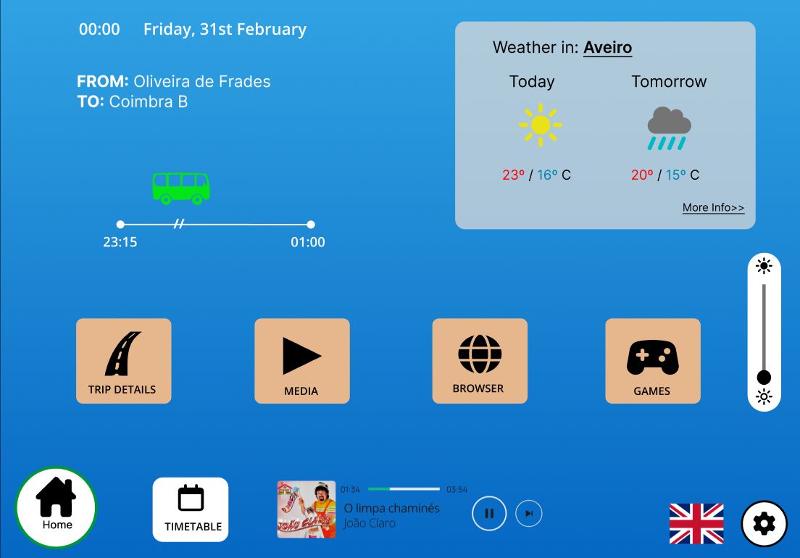
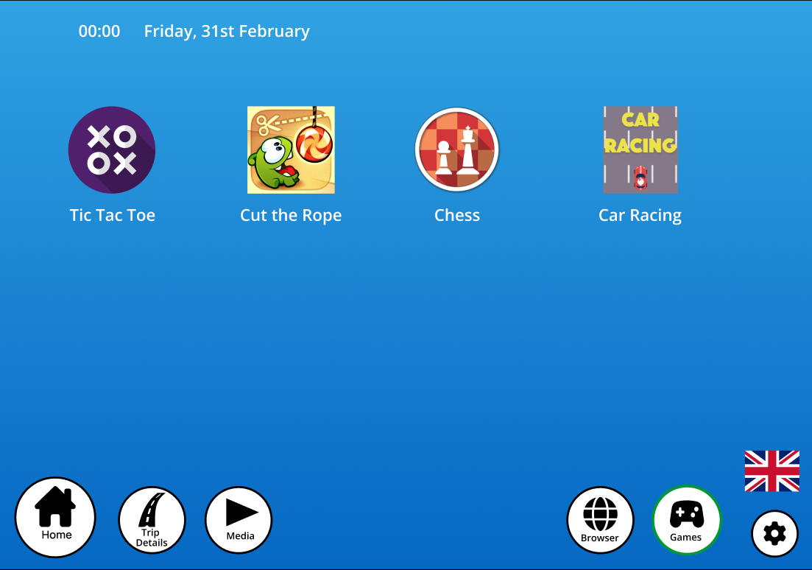
Low Fidelity Prototype (LFP)
Digital Prototype made with Figma
Home Screen
Games Page
HCI 2022-2023
‹#›
Notes:
General layout of the system
Check current location of the bus and trip details
Check timetables
Play some games

Slide 14
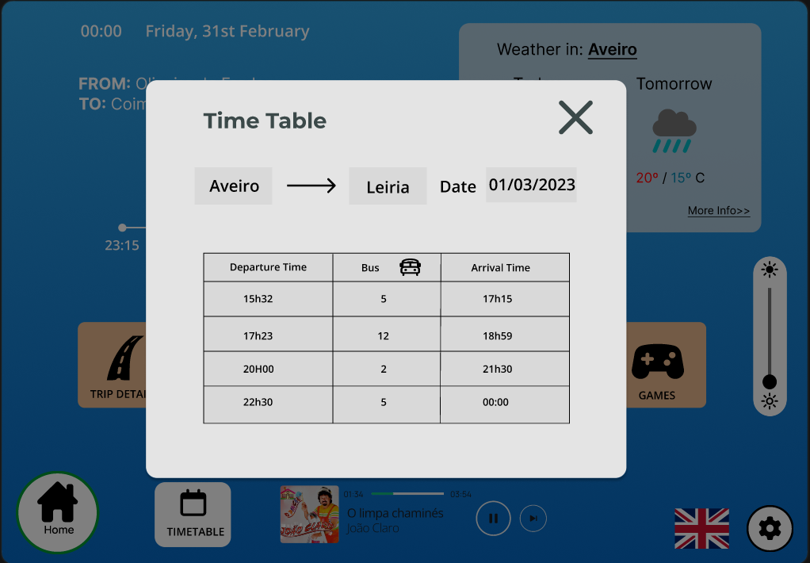
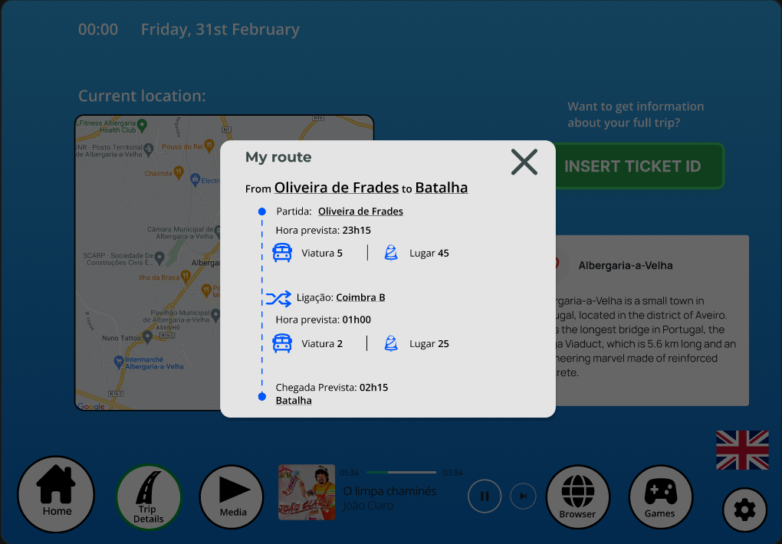
Low Fidelity Prototype (LFP)
Digital Prototype made with Figma
Time Table Modal
Trip Details Modal
HCI 2022-2023
‹#›
Notes:
Check current location of the bus and trip details

Slide 15

LFP User Evaluation
Low Fidelity Prototype
Usability tests with 9 young adults
Testers were asked to complete the following tasks:
Where is the bus currently located?
When is the last bus stop and at what time does the ride end?
When does the last bus from Aveiro to Leiria on 01/03 leave?
Make a google search.
Play a match of Tic Tac Toe.
What is the text font size that is being used?
What sound output device is being used in the system?
This tasks were mainly focused on scenario 2 and 3
HCI 2022-2023
‹#›
Notes:
Present the method used.
What did you want to evaluate?
Method: Physically with users
We wanted to evaluate the main features of the prototype, using all the personas and scenarios
Which personas and scenarios were addressed?
What tasks were used?
How many participants and which profiles?
Present the main results
Present new features identified and changes you may have made to the conceptual model.
END OF 1st DEVELOPMENT CYCLE!

Slide 16
LFP User Evaluation
Results
Main error: Task 2
Tasks related to Settings page were a little bit problematic
Remaining tasks complying with the expected
Task completion ratio : 90%
8 out of the 9 failed tasks were from the 2nd Task.
Main Suggestions:
Be able to see the sound output device on the music panel
Specify the current bus
Increase the visibility and change the label on the button to find the full route
HCI 2022-2023
‹#›
Notes:
Task 2- Principalmente problema de contexto, mas sentimos que podíamos melhorar. Para isso acrescentámos uma label, mas sentimos que não melhorou
Task 2 seemed to be confusing for most testers, only being completed by 1.
We attribute this mainly to lack of context, but the problem was noted and considered when developing the Functional Prototype.
The last two tasks ( that were related to the Settings page ) also caused some confusion, because the users didn’t understand immediately that they were supposed to go there.

Slide 17
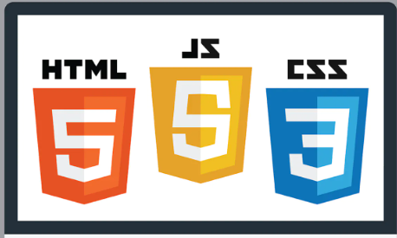



FP - Technologies Used
Batalha Bus
Functional prototype developed with React JS and Tailwind CSS
Material UI Library and Leaflet JS were also used to help develop components and maps
Prototype designed for a tablet screen with size 1194x834
HCI 2022-2023
‹#›
Notes:
Porque escolhemos estas tecnologias?
Já que tínhamos que desenvolver um website, aproveitámos esta oportunidade para aprendermos novas tecnologias como React e TailWind (O rafael já tinha conhecimentos de React).
Para tornarmos mais rápido o desenvolvimento, usámos o material UI, e depois personalizámos ao nosso gosto

Slide 18
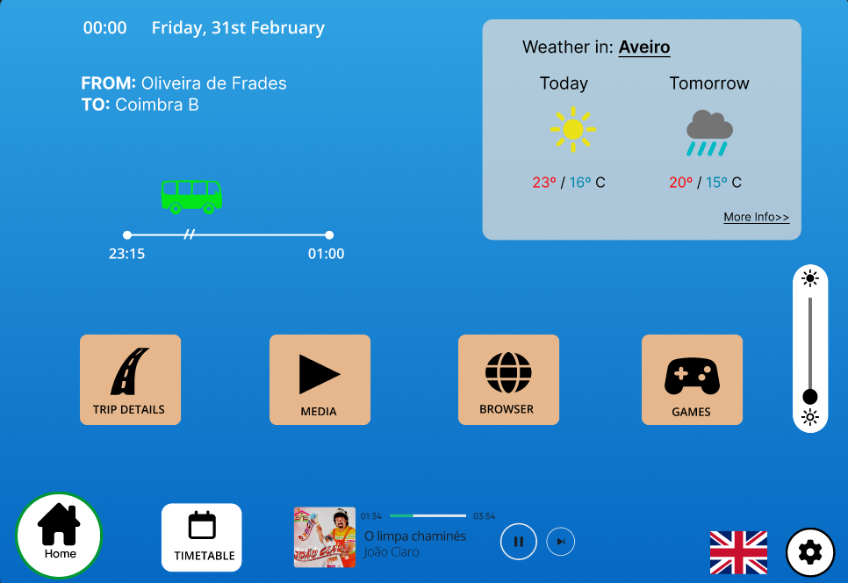
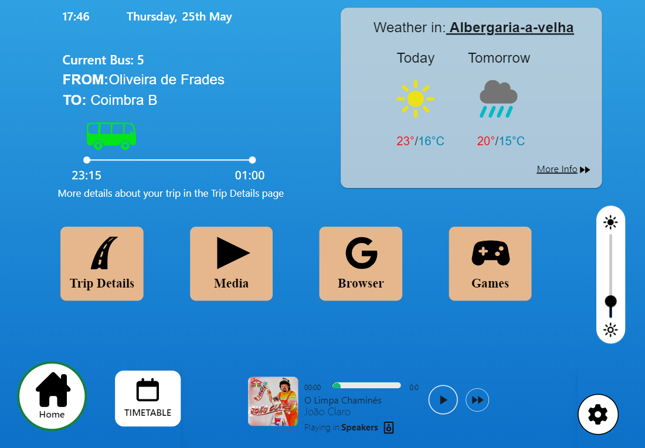
FP - Changes Made
Batalha Bus
Homepage ( LFP)
Homepage (FP)
HCI 2022-2023
‹#›
Notes:
As mudanças de usabilidade estão a vermelho. De resto, as mudanças foram de estilo

Slide 19
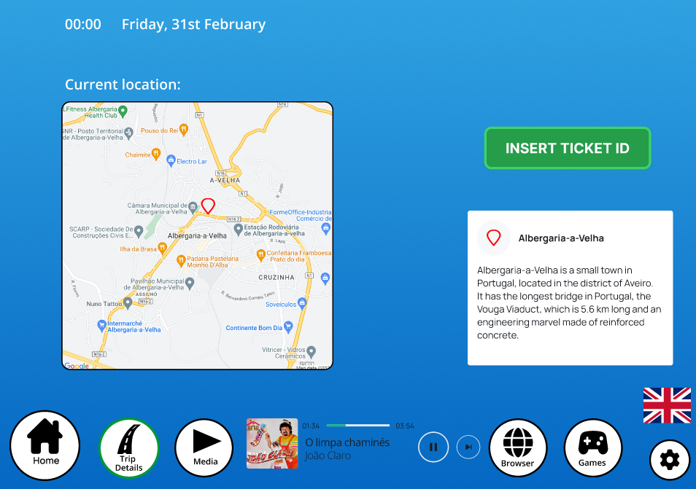
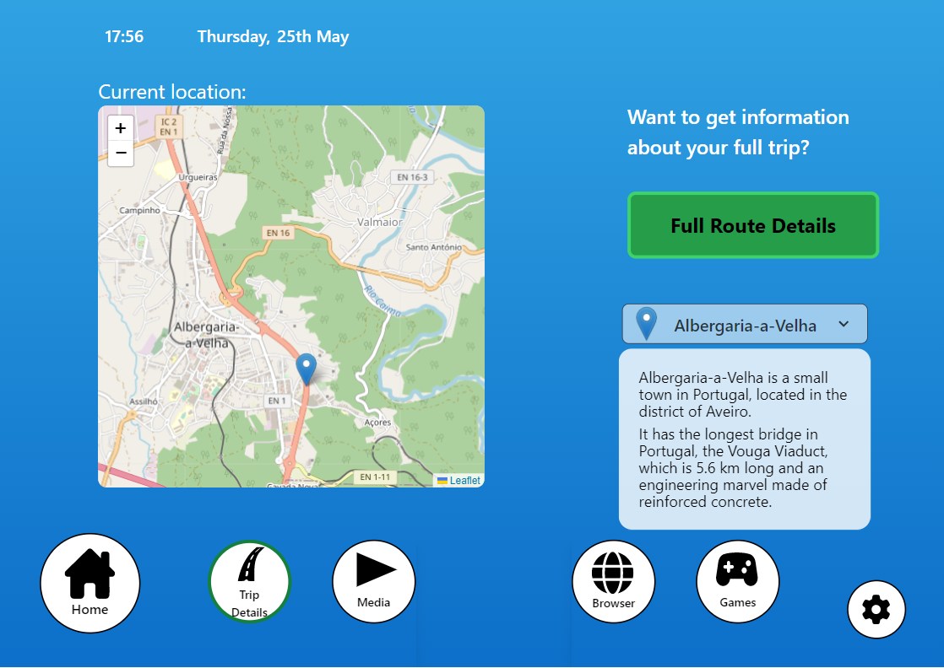
FP - Changes Made
Batalha Bus
Trip Details ( LFP)
Trip Details (FP)
HCI 2022-2023
‹#›
Notes:
Usámos Leaflet.JS

Slide 20
FP User Evaluation
Batalha Bus
Method : Usability tests in person
Total of 7 tests done by young adults
We used the same tasks as LFP, with minor differences, to evaluate the improvements done
The tasks addressed mostly scenarios 2 and 3
We couldn’t address scenario 1 because it required the implementation
of an external app within the website ( Spotify )
HCI 2022-2023
‹#›
Notes:
What was the goal? What did you want to evaluate?
Which persona(s) and scenarios were addressed?
What tasks were used?
Meter novas tasks
How many participants and which profiles?
Meter quantos foram e o género e a idade
What questionnaires where used?
Meter as perguntas??? Ou gráficos com resultados?

Slide 21
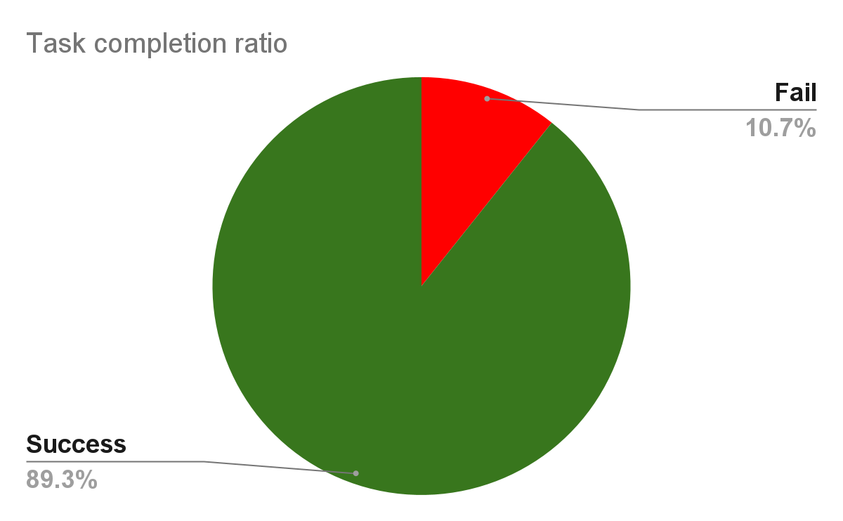
FP User Evaluation - Results
Batalha Bus
Task 2 was again the major problem
All of the 6 failed tasks were from the 2nd Task.
We felt like we failed again to provide enough context for this task for to be completed successfully.
Task completion ratio : 89%
HCI 2022-2023
‹#›

Slide 22
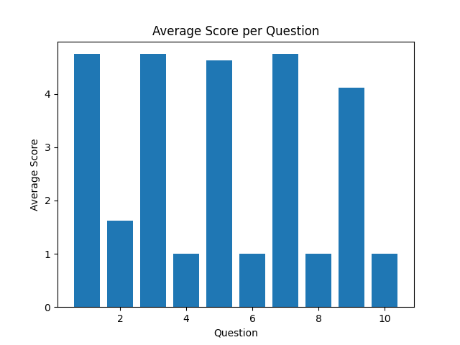
System Usability Scale (SUS) Results
Batalha Bus
A post-task questionnaire was provided to every tester after finishing the tasks.
On even numbered questions the best score is 5 and on odd numbered questions the best score is 1.
Testers seemed to be pretty satisfied with the overall usability of our system.
Overall SUS Score : 93
HCI 2022-2023
‹#›

Slide 23

FP Heuristic Evaluation
Batalha Bus
After finishing our work, , we feel like we could still improve in some aspects:
Based on Nielsen’s heuristics, we found the following problems:
#01 → Visibility and system status
Add haptic feedback to buttons
#04 → Consistency and standards
Confusion between current bus info and full trip info
#10 → Help and Documentation
We failed in providing some information, regarding some important details.
HCI 2022-2023
‹#›

Slide 24
Demo
BatalhaBus
HCI 2022-2023
‹#›

Slide 25
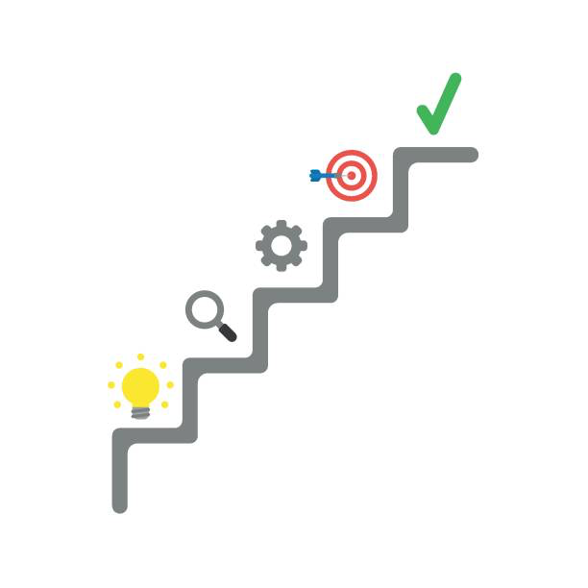
Future work
Batalha Bus
Settings making real changes on the interface
Support for other languages
White mode and dark mode
Responsive interface for more screens
Support for more games and applications
Develop a database to support the product
Design the physical system
HCI 2022-2023
‹#›

Slide 26
Acknowledgments
Thanks to everyone who helped us with usability and heuristic tests.
Special thanks to the people that suggested new ideas to implement and UI details to
improve our system.
Special thanks to the professor, for guiding us through this project.
Thanks to Leiria ( that exists ) , for giving us the one and only, Batalha.
Effort of each group member
João Luís -> 35 %
Rodrigo Aguiar -> 35 %
Rafael Ferreira -> 30 %
HCI 2022-2023
‹#›

Slide 27




Thank you for listening to our presentation !
Feel free to ask any questions.
HCI 2022-2023
‹#›

Slide 28
HCI - Assignment n.2
Design and prototyping of an application using a human-centered approach
Final presentation and demo
Project Title: BatalhaBus, a entertainment/multimedia system for bus rides
Group: Rafael Ferreira, João Luís & Rodrigo Aguiar
Lab Class: P5
HCI 2022-2023
‹#›

